Slide 1
Canadian Bat Phenology
BIS 15L Winter Group 7
By: Darius Arasteh, Wenliang Weng, and Zirui Zheng

Slide 2
Agenda
Site Type App
Data Exploration
Reproductive App
Morpho and Spatial App

Slide 3
Dataset Intro and Analytical Methods
Myotis Acoustic Data:
Ultrasonic Sensor data from 5 sites filtered to isolate Myotis calls.
Myotis Capture Data:
Records of individual bats captured during emergence, analyzed for health, reproductive status, and dimensions and tagged for future ID.
Our Goal:
Use ShinyApps to present the data to people of varying ecological knowledge

Slide 4
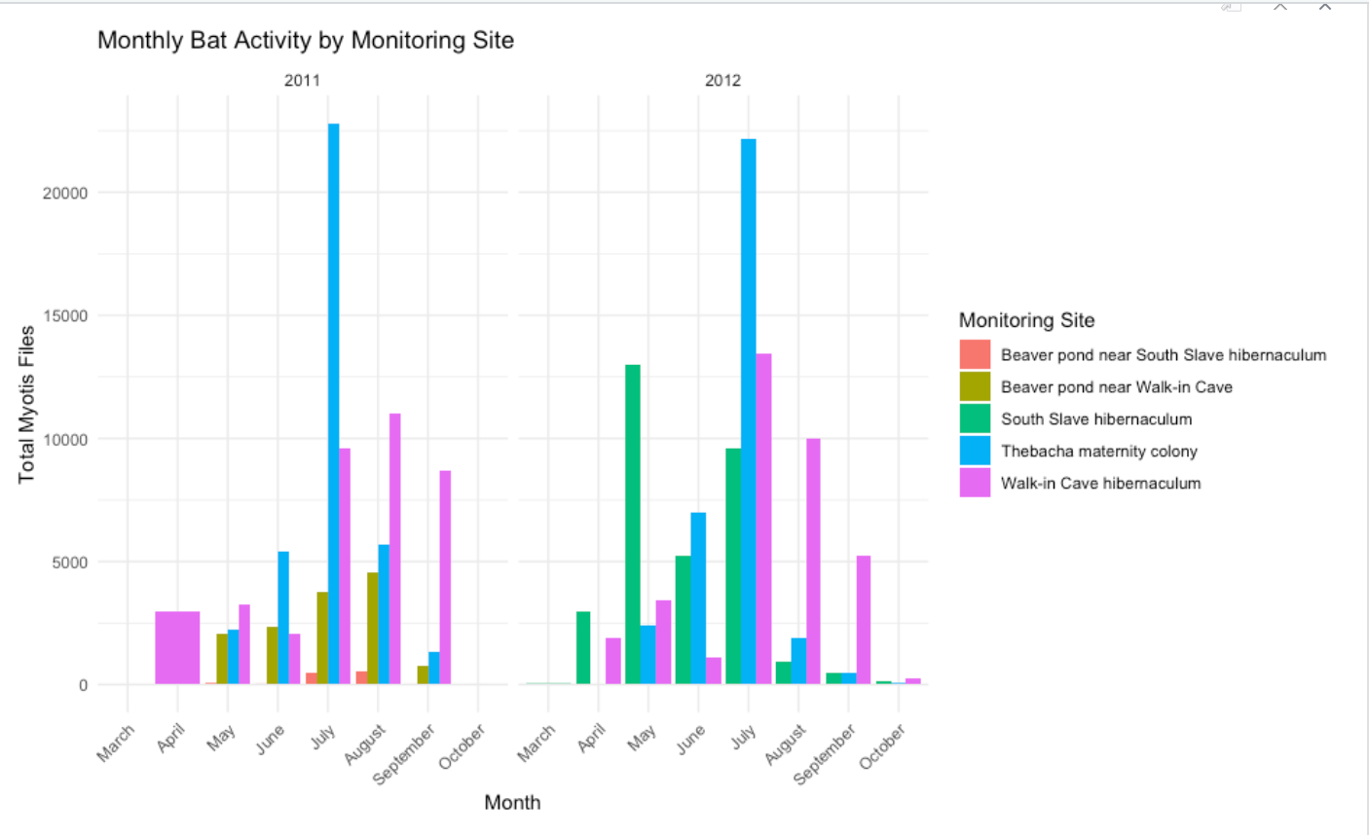
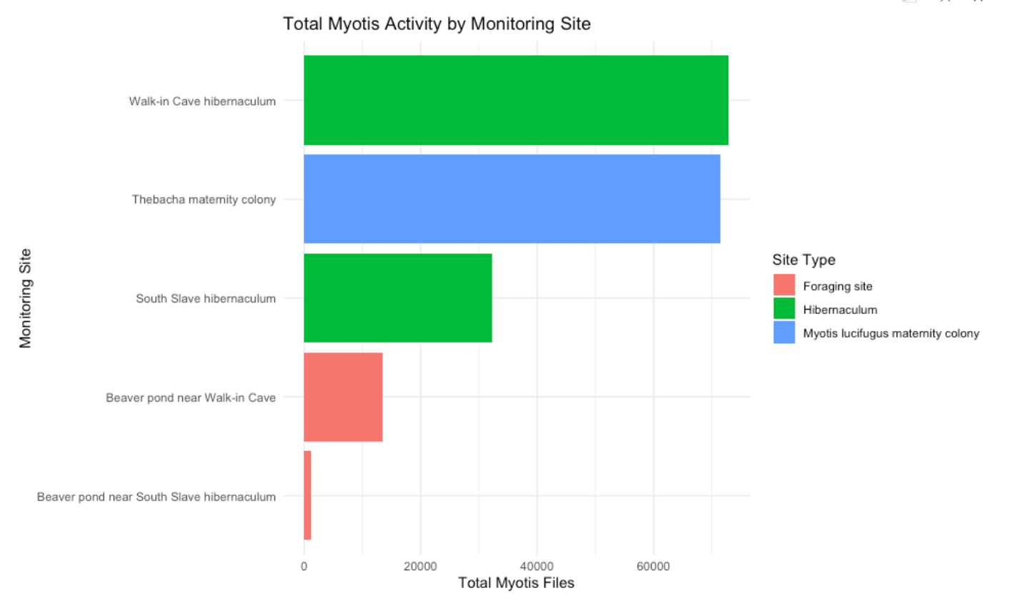
Data Exploration
Key Variables- Site Type and Activity (PERSON 1)
Notes:
Hi everyone! Our project looks at little brown bats using acoustic data, which means recordings from bat detectors that pick up bat calls at night. In our dataset, Myotis detections are basically a count of how many bat call events were recorded, so higher detections usually mean more bat activity.
We made two graphs. Graph 1 shows total bat activity by month, which helps answer: “When is activity highest across the season?” Graph 2 compares total activity across **habitat types, which helps answer: “Which habitats have the most activity?”

Slide 5
Data Exploration
Key Variables- Reproductive Status and Timing(PERSON 2)
INSERT REPRODUCTIVE STATUS OVER
A YEAR GRAPH
INSERT REPRODUCTIVE TIMING GRAPH

Slide 6
Data Exploration
Key Variables- Morphology and Spatial Interpretation (PERSON 3)
REPRODUCTIVE STATUS AND MASS GRAPH
BODY MASS ACROSS SEASON GRAPH

Slide 7
Site Location (Person 3)
Mercury is the closest planet to the Sun
Venus
Venus is the second planet from the Sun
Saturn
Saturn is composed of hydrogen and helium

Slide 8
Seasonal Activity ShinyApp
Notes:
Finally, we built a Shiny app, which is an interactive webpage made in R. It lets you filter the data—meaning you can choose a year or habitat type—and the plots update automatically. This makes it easier to explore patterns and understand when and where bats are most active.
Site type tells us what each detector location represents in a bat’s life cycle. A foraging site is where bats fly at night to hunt insects, so activity often reflects feeding behavior. A hibernaculum is a winter shelter, usually a cave or mine, where bats hibernate to conserve energy and activity is usually low. A maternity colony is a summer roost where female bats give birth and raise pups, often producing very high activity.

Slide 9
Reproductive Timing ShinyApp

Slide 10
Morphology/Spatial ShinyApp

Slide 11
Thanks!
Do you have any questions?
youremail@freepik.com
+34 654 321 432
yourwebsite.com
Please keep this slide for attribution

Slide 12
Icon pack

Slide 13
Alternative resources
Here’s an assortment of alternative resources whose style fits that of this template:
Vectors:
Halloween elements collection in flat design

Slide 14
Resources
Did you like the resources used in this template? Get them for free at our other websites:
Vectors:
Halloween forest background
Flat design forest landscape I
Flat design forest landscape II
Flat design forest landscape III
Template of halloween evil pumpkins and witches
Hand drawn halloween background
Flat halloween elements with creepy style
Set of halloween borders
Vector flat design usa states outline map
Icons:
Icon Pack: Halloween | Flat
Photos:
Halloween paper bats on window
Nature before night time

Slide 15
Instructions for use
If you have a free account, in order to use this template, you must credit Slidesgo by keeping the Thanks slide. Please refer to the next slide to read the instructions for premium users.
As a Free user, you are allowed to:
Modify this template.
Use it for both personal and commercial projects.
You are not allowed to:
Sublicense, sell or rent any of Slidesgo Content (or a modified version of Slidesgo Content).
Distribute Slidesgo Content unless it has been expressly authorized by Slidesgo.
Include Slidesgo Content in an online or offline database or file.
Offer Slidesgo templates (or modified versions of Slidesgo templates) for download.
Acquire the copyright of Slidesgo Content.
For more information about editing slides, please read our FAQs or visit our blog:
https://slidesgo.com/faqs and https://slidesgo.com/slidesgo-school

Slide 16
Instructions for use (premium users)
As a Premium user, you can use this template without attributing Slidesgo or keeping the Thanks slide.
You are allowed to:
Modify this template.
Use it for both personal and commercial purposes.
Hide or delete the “Thanks” slide and the mention to Slidesgo in the credits.
Share this template in an editable format with people who are not part of your team.
You are not allowed to:
Sublicense, sell or rent this Slidesgo Template (or a modified version of this Slidesgo Template).
Distribute this Slidesgo Template (or a modified version of this Slidesgo Template) or include it in a database or in any other product or service that offers downloadable images, icons or presentations that may be subject to distribution or resale.
Use any of the elements that are part of this Slidesgo Template in an isolated and separated way from this Template.
Register any of the elements that are part of this template as a trademark or logo, or register it as a work in an intellectual property registry or similar.
For more information about editing slides, please read our FAQs or visit our blog:
https://slidesgo.com/faqs and https://slidesgo.com/slidesgo-school

Slide 17
Fonts & colors used
This presentation has been made using the following fonts:
Aclonica
(https://fonts.google.com/specimen/Aclonica)
Darker Grotesque
(https://fonts.google.com/specimen/Darker+Grotesque)
#16305b
#e5d2f3
#efe3fa
#f9f4ff
#fefcff
#ec9239
#a07fbe
#4b4390
#211f57
#ffffff

Slide 18





Storyset
Create your Story with our illustrated concepts. Choose the style you like the most, edit its colors, pick the background and layers you want to show and bring them to life with the animator panel! It will boost your presentation. Check out how it works.
Pana
Amico
Bro
Rafiki
Cuate

Slide 19
Use our editable graphic resources...
You can easily resize these resources without losing quality. To change the color, just ungroup the resource and click on the object you want to change. Then, click on the paint bucket and select the color you want. Group the resource again when you’re done. You can also look for more infographics on Slidesgo.

Slide 22
JANUARY
FEBRUARY
MARCH
APRIL
MAY
JUNE
PHASE 1
Task 1
Task 2
PHASE 2
Task 1
Task 2
JANUARY
FEBRUARY
MARCH
APRIL
PHASE 1
Task 1
Task 2

Slide 25
...and our sets of editable icons
You can resize these icons without losing quality.
You can change the stroke and fill color; just select the icon and click on the paint bucket/pen.
In Google Slides, you can also use Flaticon’s extension, allowing you to customize and add even more icons.

Slide 26
Educational Icons
Medical Icons

Slide 29
Creative Process Icons
Performing Arts Icons

Slide 30
Nature Icons

Slide 31
SEO & Marketing Icons

Slide 32


